Slide 1

COUPON ACCEPTANCE PREDICTION PROJECT
Khushal Gogia
21/06/2023

Slide 2
INTRODUCTION
In Today's competitive market, businesses are constantly seeking innovative ways to attract and retain customers.
Coupons play a crucial role in incentivizing purchases and driving Customer Loyalty.
However, distributing coupons without considering individual customer preferences and behavior can result in low redemption rates and wasted resources.

Slide 3
SIGNIFICANCE
Resource Optimization: Instead of distributing coupons randomly or uniformly, they can focus on customers who are more likely to accept the coupons, resulting in higher redemption rates and cost savings.
Improved Marketing ROI: By delivering offers that resonate with customers and are more likely to be accepted, businesses can increase sales, customer loyalty, and overall marketing effectiveness.
Enhanced Customer Satisfaction: Customers are more likely to engage with offers that align with their interests and needs, leading to a positive perception of the brand and increased customer loyalty.

Slide 4
OBJECTIVE
The goal of this project is to develop a predictive model that can accurately forecast whether a customer will accept a coupon or not.
By leveraging advanced machine learning techniques and analyzing various customer attributes and purchase history, we aim to provide personalized coupon recommendations that maximize acceptance rates and drive sales.

Slide 5
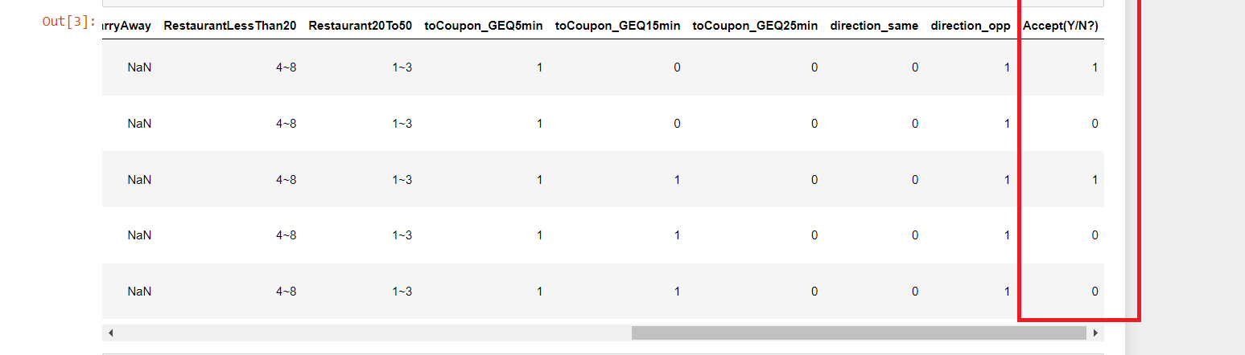
FEATURES AND TARGET VARIABLE
Target variable for this project is "Acceptance," which indicates whether a customer accepted a given coupon or not. This variable serves as our outcome of interest and forms the basis for training and evaluating our predictive models.
Features in this project helps the model to identify and predict whether the customer accept the coupon or not
These features include temperature, weather, gender, coupons expiration, age etc.
We are also provided user’s occupation and income

Slide 6
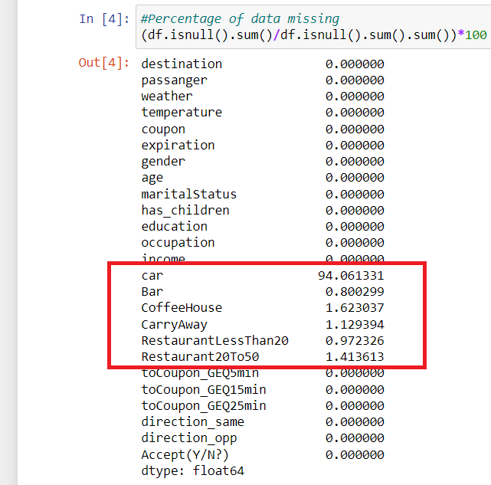
DATA PRE-PROCESSING
NULL values: There are so many null values in the dataset
For example, 94% of the car column is null values, so we had to remove that column
Whereas other columns with null values are objects, we dealt those column by replacing null values with the mode(most frequent element

Slide 7
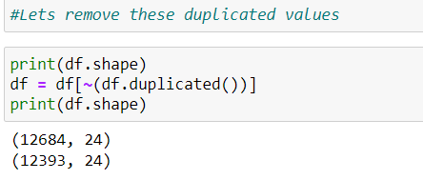

DUPLICATE VALUES
However, there were 291 duplicate values in the dataset
As you can see in the image, we remove those duplicate columns as it will affect our model building afterwards

Slide 8
ENCODING
Encoder | Features
One – Hot Encoder | Destination , coupon, occupation
Label Encoding | expiration, gender
Ordinal Encoder | age, Bar, Coffeehouse, CarryAway, RestaurantLessThan20, Restaurant20To50
So, this dataset required us to deal with different column differently,
That’s why I used 3 different types of encoding techniques for different columns

Slide 9
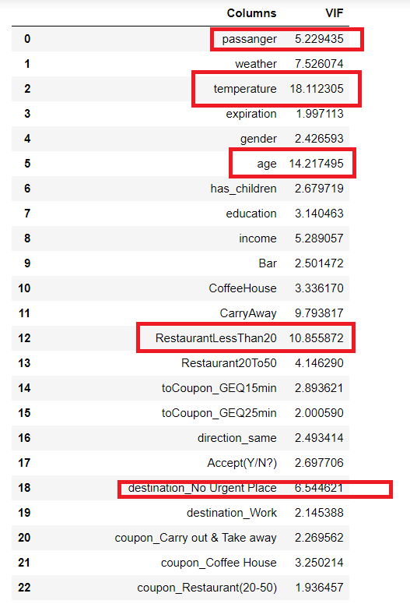
Multi-Collinearity
I had used variance inflation factor method to check multi-collinearity
As shown in the image, data has multi-collinearity problem as many variables having VIF more than 5
So accordingly, I had removed several highly co-related columns

Slide 10
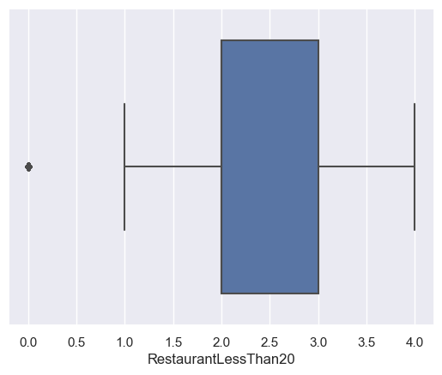
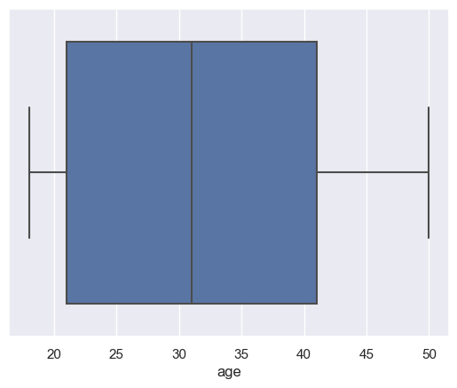
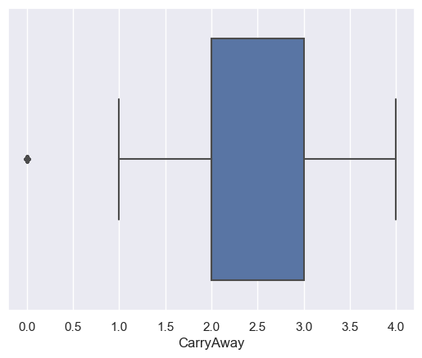
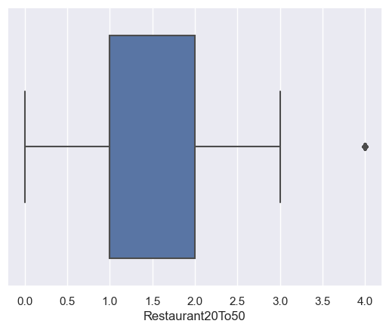
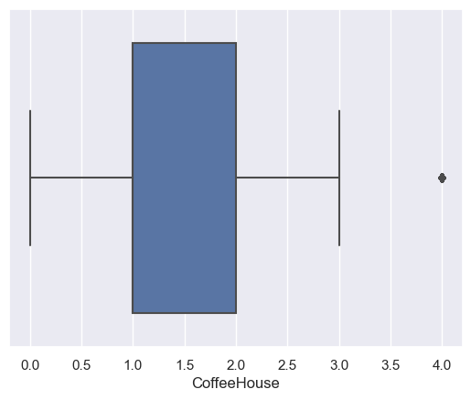
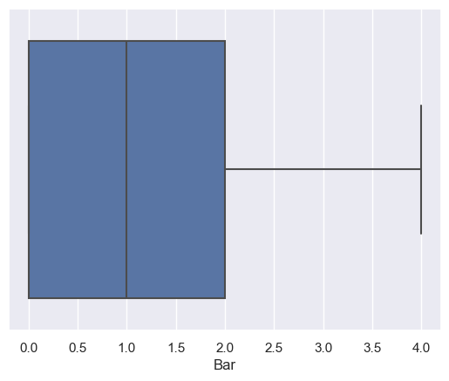
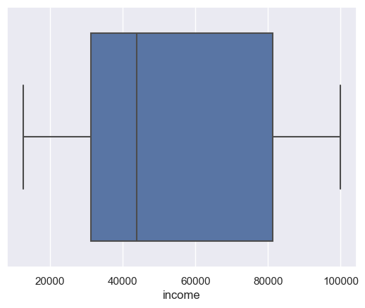
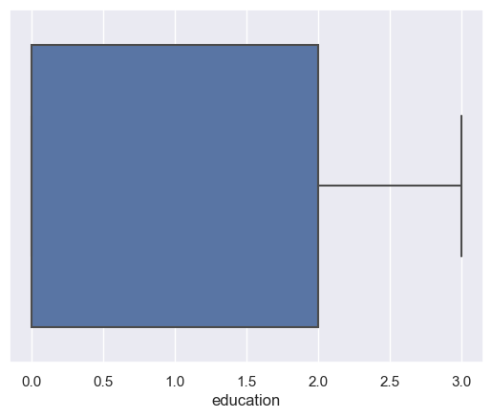
NO Outliers

Slide 11
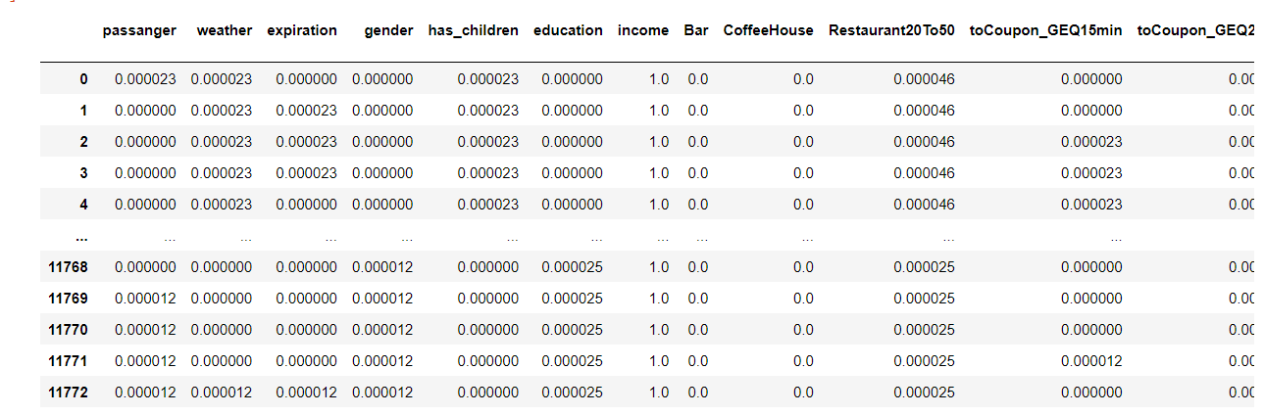
Feature Scaling
Feature scaling has become the necessity as there are different range of data,
and Scaling the data will help in the process of model building

Slide 12
Exploratory Data Analysis (EDA)

Slide 13
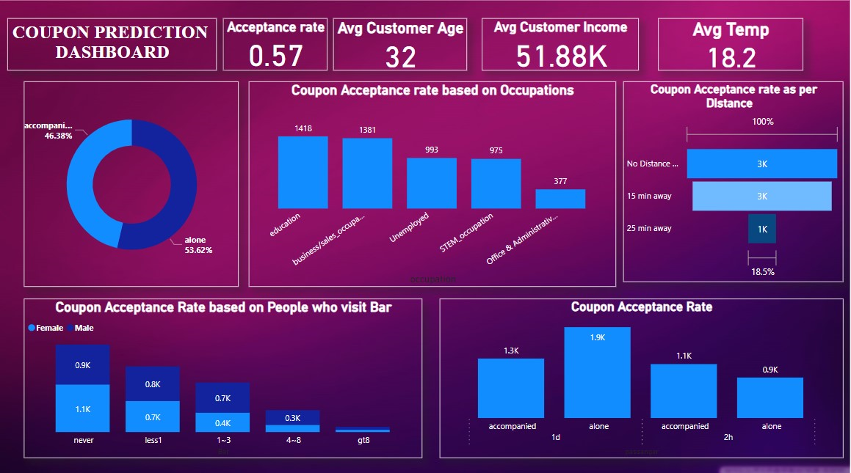

Slide 14
KEY POINTS
Coupon having 1 day validity seems to work more
Customers having age segment 21 or less than 21 could be our target audience
People generally accept the coupon in sunny weather
Mostly people with no acquaintances are accepting the coupon
Lesser the distance from restaurant, better the acceptance rate
Coupon acceptance rate is directly proportional to Restaurant, and inversely proportional to Coffehouse and bars

Slide 15
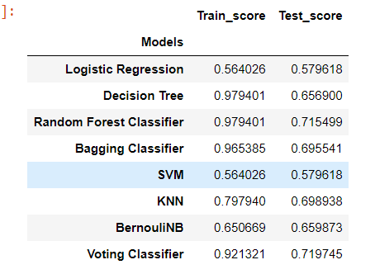
Model training
I trained the model using Logistic Regression, Decision Tree, Random Forest, Bagging Classifier, SVM,KNN and Voting Classifier
However, Random Forest and Bagging Classifier seems to more accurate models (as shown in the figure)
But There is definitely OVERFITTING problem for the model

Slide 16
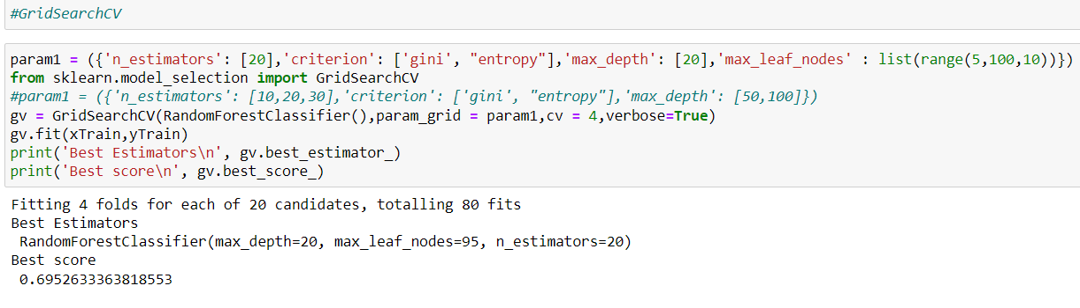
Performance Estimates
I ran GridSearchCV() on Random Forest model for hypertuning and the reliability of the model
Here are the results :

Slide 17
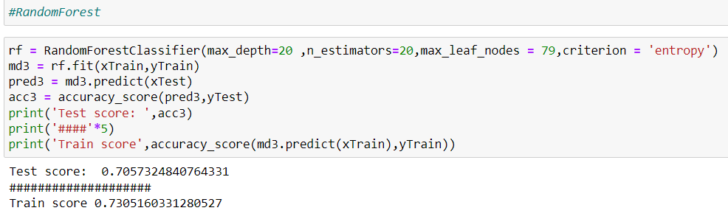
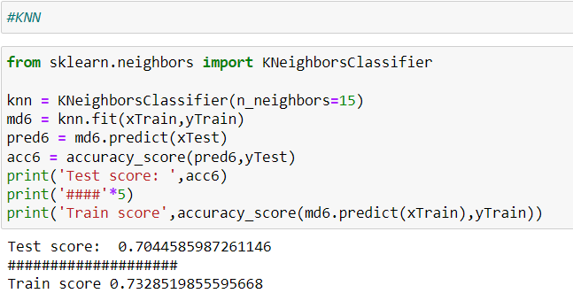
FINAL MODEL

Slide 18
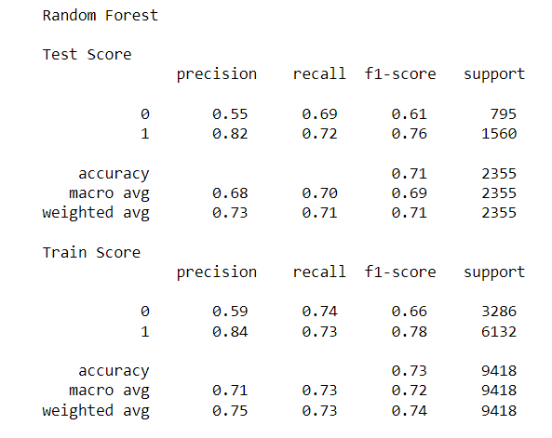
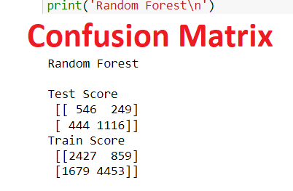
Model Evaluation

Slide 19
Insights and Recommendations:
Prioritize coupon promotions for restaurants closer to the target customers' locations
Implement loyalty programs to reward frequent customers and encourage continued engagement
Customize coupon campaigns for single individuals and consider their preferences.
Develop coupon offers and promotions that cater to customers with lower educational backgrounds.
Customize messaging and incentives to appeal to male customers.
Align coupon promotions with favorable weather conditions to increase acceptance rates.
By incorporating these insights and following the recommendations, we can optimize our coupon acceptance prediction model and improve the effectiveness of your coupon campaigns.

